Slide 1
Food and Beverage Management The sixth edition
Chapter 1
Food and Beverage Operations and Management

Slide 3
Chapter 1 covers:
Food and beverage operations
Service operations management
The hospitality industry and its products:
The experience economy
Sectors and types of food service operations
Reasons for customer choices
Key influences on the food service industry
The legal framework
Developing management skills

Slide 4
Food and beverage operations
Food and beverage (or food service) operations are concerned with the provision of food and beverages within business

Slide 5
Food and beverage management
Management of:
the service sequence (delivery)
the customer process (experience)
the survival of the business
Requires skills in marketing, customer relations, and operations, staff and financial management

Slide 6
Food and beverages
Food: includes a wide range of styles and cuisine types
Beverages: includes all alcoholic and non-alcoholic drinks, cold and hot

Slide 7
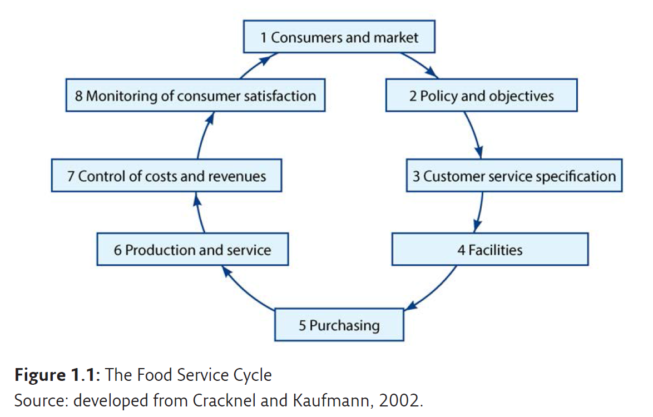
The Food Service Cycle

Slide 8
The Food Service Cycle
Framework to analyse and compare different food service operations
Helps to understand how an individual operation works:
Difficulties in one element of the cycle will cause difficulties in the elements that follow
Difficulties experienced in one element of the cycle will have their causes in preceding elements

Slide 9
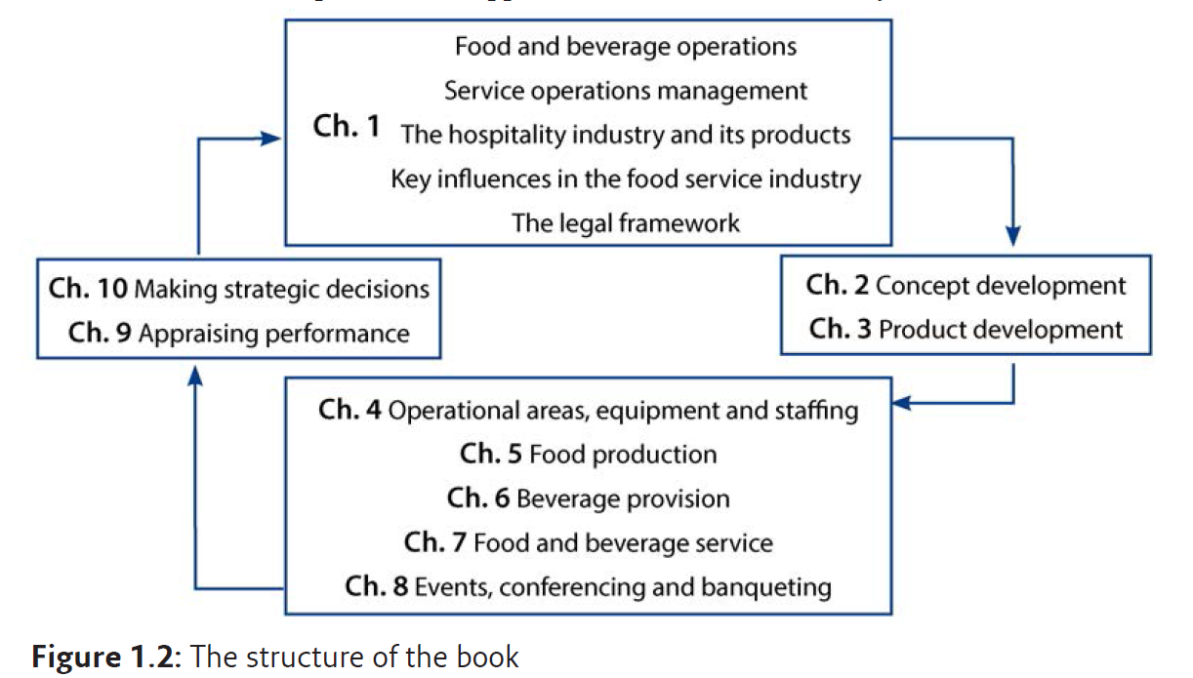
Structure of the book
Based on The Food Service Cycle

Slide 10
Systems approach
Two dimensions:
Systematic approach to the design, planning and control of a food and beverage operation
The management of the operating systems within a food and beverage operation

Slide 11
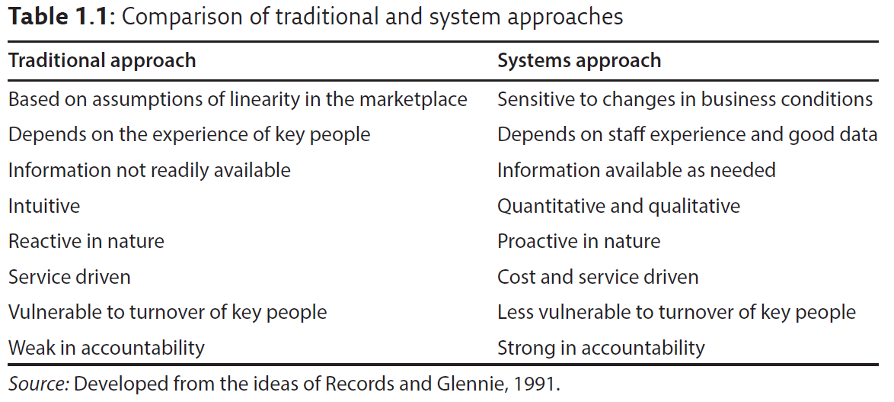
Traditional vs systems approaches

Slide 12
Management of operations
The management of:
Materials
Information
People (customers)

Slide 13
Four systems for food service
Food production
Beverage provision
Delivery or the service sequence
Customer management or the customer process

Slide 14
Food and beverage operation

Slide 15
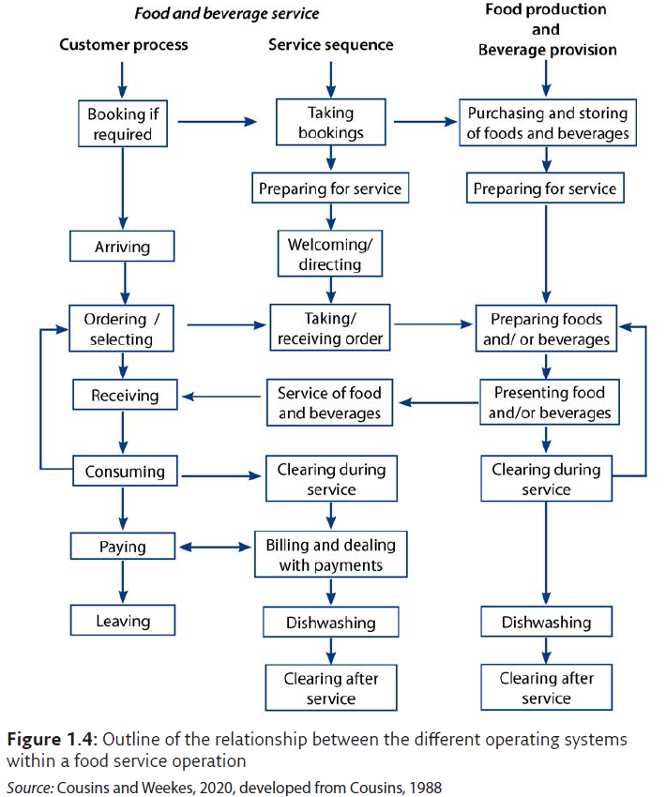
Interrelationship of the four systems of a food service operation

Slide 16
Food and beverage systems
Food production and beverage provision are ‘hard’ systems, as they are expected to behave predictably
Customer process is a ‘soft’ system because it involves personal rather than technical aspects
Service sequence contains characteristics of both ‘hard’ and ‘soft’ systems
It is ‘hard’ in the technical and procedural aspects of service and ‘soft’ because there are aspects to do with interactions between staff and customers, and between staff and staff

Slide 17
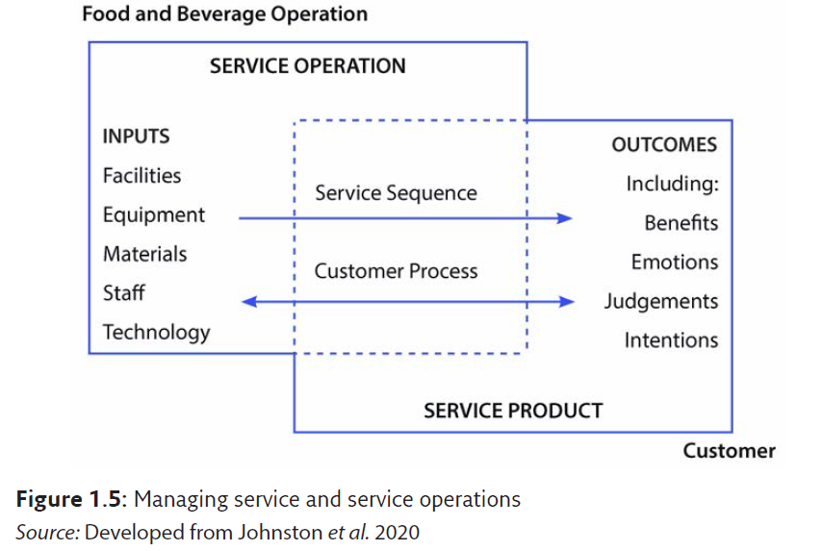
Managing service operations

Slide 18
Hospitality industry
Provides food, drink and accommodation
Hospitality encompasses all aspects of the hotel and catering (or food service) industries
Hospitality refers to the creation of experiences: which is what people working in hospitality do

Slide 19
The food service product
Previously products were often divided into goods and services
The modern approach only refers to products
All products have production and delivery elements
All products have some form of tangible (or physical) element, and all services have some intangible (or non-physical) element
In the hospitality industry these two elements are operating side by side

Slide 20
The experience economy
Customers
do not buy service delivery, they buy experiences
do not buy service quality, they buy memories
do not buy food and drink, they buy meal experiences
Pine and Gilmour (1999) and Hemmington (2007)

Slide 21
Example comparison of roles

Slide 22
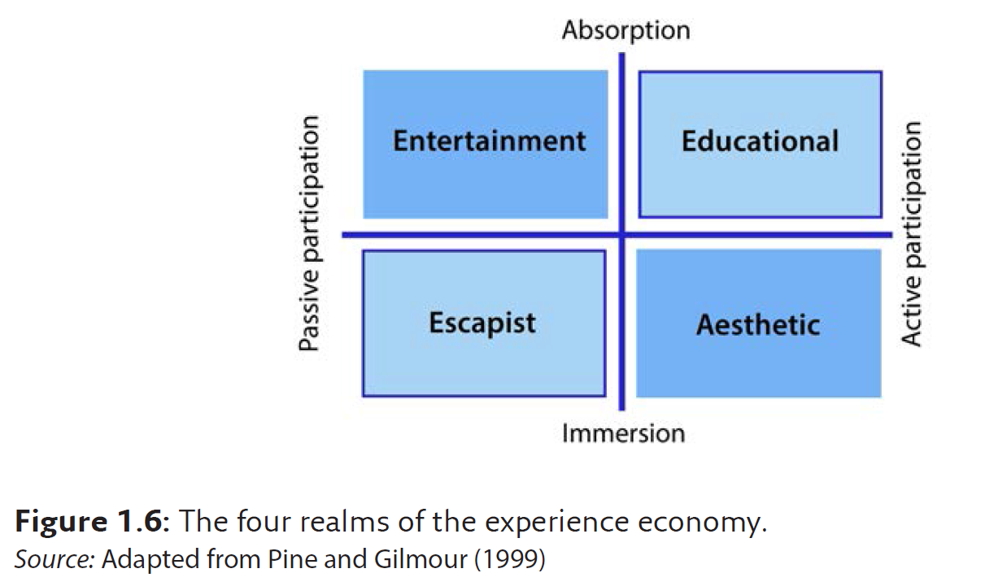
The four realms

Slide 23
Four realms in food and beverage

Slide 24
Five perspectives of hospitality
Host/guest relationship - need to take responsibility
Generosity - e.g. reducing the number of extras to be paid for
Theatre and performance - provide experiences that are personal, memorable and add value to customers’ lives
Creating lots of little surprises - include additional items the customer is not expecting
Safety and security - showing genuine concern
Hemmington (2007)

Slide 25
Dimensions of the hospitality product
Intangibility
Perishability
Variability of output
Inseparability
Simultaneous production and consumption
Ease of duplication
Demand variation
Difficulty of comparison

Slide 26
Sectors of the industry
Hotels and other tourist accommodation
Restaurants, casual, popular catering, fast food, takeaway
Motorway service stations
Retail stores
Events/banqueting/conferencing/exhibitions
Leisure attractions
Industrial catering (cost sector - business and industry)
Welfare catering
Licensed trade
Transport catering
Event catering (off-premises catering)

Slide 27
Variables in food service sectors
Historical background
Reasons for customer demand
Size of sector (number of outlets and turnover)
Policies: financial, marketing, catering
Interpretation of demand/catering concept
Technological development
Influences / State of sector development
Primary/secondary activity
Types of outlets
Profit orientation/cost provision
Public/private ownership

Slide 28
Profit and cost markets
Profit market - includes hotels, commercial restaurants, pubs, fast food and leisure outlets
Cost market - includes catering in business and industry, education, healthcare and the armed forces

Slide 29
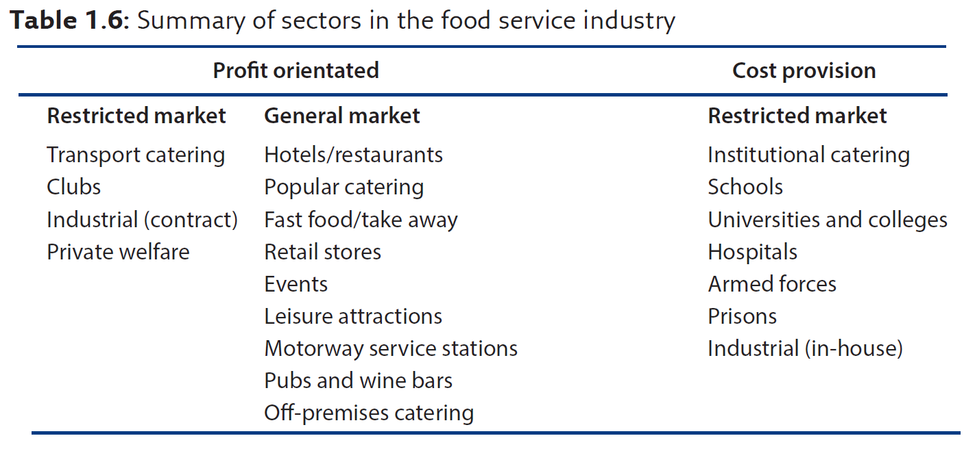
Summary of food service sectors

Slide 30
Food and restaurant styles (1 of 2)
Bistro
Brasserie
Caféteria
Casual dining
Cloud/ghost/dark/virtual kitchens
Coffee shop / café
Country house hotel cooking
Ethnic cuisine (national or ethnic origins)
Farmhouse cooking
Fine dining / First class restaurant
Fusion / Eclectic Cuisine
Health food and vegetarian restaurants

Slide 31
Food and restaurant styles (cont’d)
International designation restaurants
Molecular gastronomy
New wave brasserie (Gastrodome)
New/modern British/French
Popular catering
Pop ups
Public houses / gastro pubs
Restaurant
Street food/commune food
Take away and fast food
Themed restaurant
Wine bars

Slide 32
Customer is central
To the process and an active participant within it
Understanding the customer is critical to the success of food service operations

Slide 33
Different food service operations
Designed for the:
Needs people have at the time
Rather than for the type of people they are
The same customer can be:
A business customer during the week
A member of a family at the weekend
Wanting a quick lunch or snack while travelling
Organising a special event

Slide 34
Two types of market
General market
Non-captive: customers have a full choice
Restricted market
Captive: customers have no choice
Semi-captive: customers have a choice before choosing but then have little choice of food and drink other than that on offer

Slide 35
Main aim of a food service operation
To achieve customer satisfaction
By meeting the customers’ needs:
Physiological
Economic
Social
Psychological
Convenience
Customers may want to satisfy some or all of these needs

Slide 36
Reasons for a customer’s choice
Often determine the customer’s satisfaction or dissatisfaction
Dissatisfaction can come from:
Aspects of the food and beverage operation
Aspects beyond the operation’s control
Either way the operation has to deal with it

Slide 37
Potential dissatisfactions
Controllable by the establishment e.g., scruffy, unhelpful staff, cramped conditions
Uncontrollable e.g., behaviour of other customers, the weather, transport problems

Slide 38
Product augmentation
Core of the product
The food and drink provision
Tangible elements of the product
The methods of delivery
Augmentation of the product
Takes into account the complete package
Competition mostly takes place at the augmented level

Slide 39
Reasons for eating out
Convenience
Variety
Labour
Status
Culture / tradition
Impulse
No choice

Slide 40
Meal experience factors
Food and drink on offer
Level of service
Level of cleanliness and hygiene
Perceived value for money and price
Atmosphere of the establishment
The meal experience is covered in more detail within Chapter 3

Slide 41
Key influences on the industry
P Political
E Economic
S Socio-cultural
T Technological
L Legal
E Ecological or environmental

Slide 42
Key influences include:
Political changes
Disposable income / Minimum wage
Exchange rates, Inflation, Stagnation, Taxation
Materials and Fuel costs
Staff shortages
Lifestyle changes
Developments in technology
Sustainability

Slide 43
PESTLE is not perfect
Used badly it can lead to:
Data overload
Failure to try to assess the potential impact of an environmental change, however unlikely it may initially seem
Failure to recognise the combined impact of a number of influences

Slide 44
Look inwards at the organisation
Ask questions such as:
Why are we, or how can we be successful?
Is there a growing market and will it growing?
Will customers still buy our products?
What changes of policy or price are we vulnerable to?
How can the product life cycle be extended?

Slide 45
Identifying changes in PESTLE elements
Organisations need to be aware of the main external influences that affect them
But it is also important to keep a close watch on influences that may be unlikely to occur, but which could have a major impact on the organisation

Slide 46
Sources of information
Trade magazines (and their associated websites)
Various news media
Textbooks, journals, and on-line data bases
Government websites
Business Link
Professional trade reports (e.g. Keynote and Mintel)
Trade bodes
Professional bodies

Slide 47
Legal framework includes:
Health, safety and security
Licensing
Insurance
Selling goods by weights and measures
Contracts
Selling good by description
Food and beverage labelling
Avoiding discrimination
Providing services
Customer property and customer debt
Data protection

Slide 48
Important of compliance
Penalties for non-compliance can be severe, both for the business and for the management and staff
Essential for all members of staff to contribute to ensuring compliance

Slide 49
Health, safety and security
Duty to care for all staff and lawful visitors, and must not:
Sell (or keep for sale) food and beverages that are unfit for people to eat
Cause food or beverages to be dangerous to health
Sell food or beverages that are not what the customer is entitled to expect, in terms of content or quality
Describe or present food in a way that is false or misleading

Slide 50
Health, safety and security
Operation must be able to demonstrate that steps have been taken to ensure good food hygiene (due diligence)

Slide 51
Licensing
Food service operations are required to obtain a range of official licences to be able to sell food and beverages
These require:
Being registered as a business entity
Being registered as a food business
The building being designated as a food service business

Slide 52
Licensing (cont’d)
The sale of alcoholic liquor is subject to liquor licensing requirements
Other types of licences include, for example:
Pavement licence,
Licences for music (live or pre-recorded)
Dancing
Gambling
Theatrical performance
Television display

Slide 53
Insurances
Food service businesses should carry a range of insurances, including:
Liability insurance
Employee liability insurance
Public liability insurance

Slide 54
Weights and measures
Generally requires:
Display of the prices and measures used for all alcohol served
Food and beverage items for sale to be of the quantity and quality demanded by the customer
The use of officially stamped measures

Slide 55
Contracts
Made when one party agrees to the terms of an offer made by another party; this can be written or verbal
All food service establishments should be clear on:
circumstances where the operation may seek compensation from the customer
taking care when dealing with minors (persons under 18)

Slide 56
Selling goods by description
All food, beverages and other services provided must be:
fit for purpose and of satisfactory quality in relation to price and description
accurately described in terms of size, quality, composition, production, quantity and standard

Slide 57
And:
All statements of price must be clear and accurate
Food, beverages and other services must correspond to their description
Times, dates, locations and nature of service are as promised
Billing is fair, transparent and reflects the prices quoted

Slide 58
To ensure compliance
Take care when:
wording menus and wine lists
describing items to customers
stating if prices include local and/or government taxes
describing conditions such as cover charges, service charges or extras
describing the service provision

Slide 59
Food and beverage labelling
The legislation can cover requirements for:
Ingredients
Identifying allergens
Calorie counts
Environmental impact (Eco-labels which take account of cultivation, processing, and transportation)

Slide 60
Avoiding discrimination
Covers behaviour relating to discrimination on grounds of ethnic origin, race, creed, sex or disability
Three types of discrimination:
Direct discrimination
Indirect discrimination
Discrimination through victimisation

Slide 61
Providing services
Generally, no specific requirement to serve anyone
Important to be aware of:
Circumstances where there may be a mandatory requirement to provide services
Valid reasons for refusal

Slide 62
Customer property and debt
Good practice to ensure:
Care is taken of customers’ property in order to minimise potential loss or damage
Clear guidance on the procedures to follow if the customer is unable or unwilling to pay

Slide 63
Data protection
Customers have the right to expect that data about them is:
kept secure
only used for the published business purposes
Operations must ensure data is:
kept up to date, fairly, lawfully and securely
not passed on to third parties without prior consent
and, that staff are aware of required procedures

Slide 64
Developing management skills
Effective leadership is key to the success of any business. Competences required include:
Self-management
Decision making
Time management
Team leadership
Communication
Recruitment
Financial ability
Resilience

